Slide 1
Optimization

Slide 2
Stochastic Optimization
Collaboration problems may contain many possible solutions across many variables
Finding a best combination of variable may cost expensive computations
Example applications
  Physics: study molecular dynamics
  Biology: predict protein structures
  Computer Science: predict worst running time of algorithms
  Even NASA use optimization technique to design antennas

Slide 3
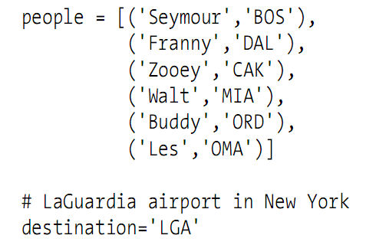
Group Travel Problem
Planning a trip for a group of people from different locations all arriving at the same place

Slide 4
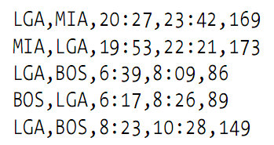
Flight Data
http://kiwitobes.com/optimize/schedule.txt
Comma-separated format
Challenge: decide which flight each person in the family should take

Slide 5
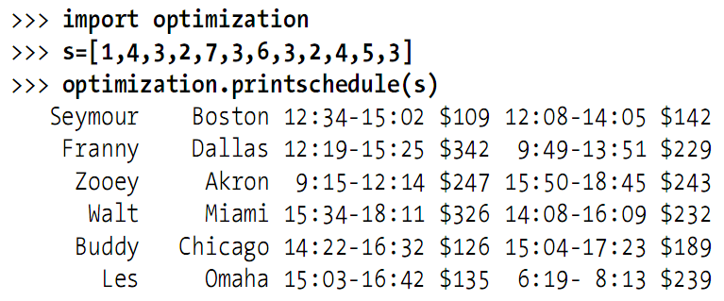
Representing Solution
Every person has a from and to flight

Slide 6
Cost Function
The key to solving optimization problem
Usually the most difficult thing to determine
In flight example, consider
  Price: plane tickets, etc.
  Travel time: flight duration
  Waiting time: wait other members
  Departure time: too early departure, cost on sleep
  Car rental period: extra day cost if return too late
  …

Slide 7
An Example of Cost Function
Try to represent cost in a single number, simplified!
1 minute on air travel = $1
1 minute waiting = $0.5
Car extra rental = $50

Slide 8
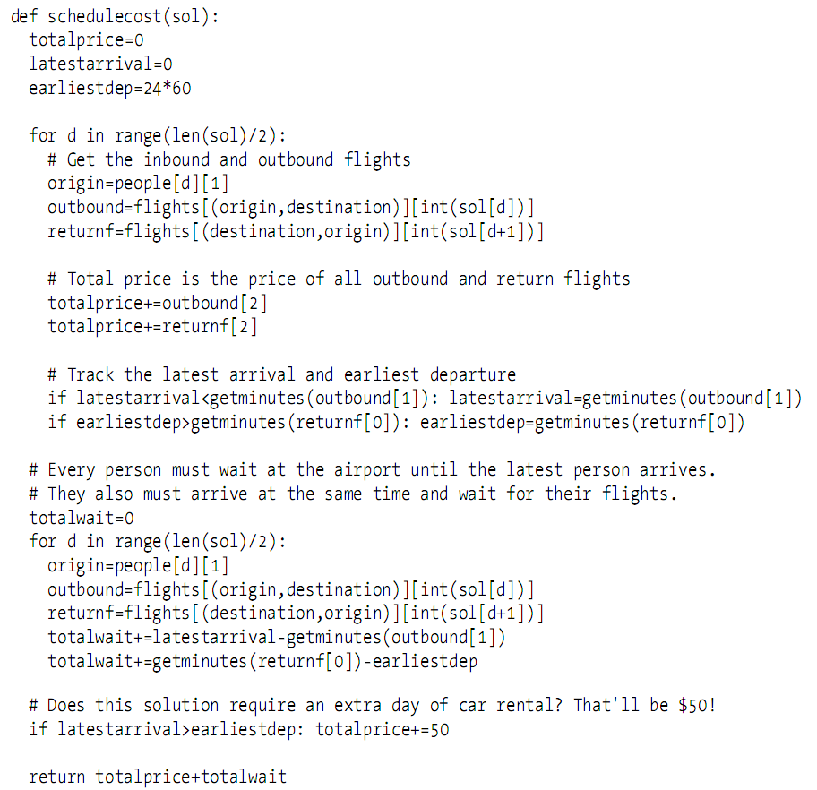
Code: Cost Function

Slide 9
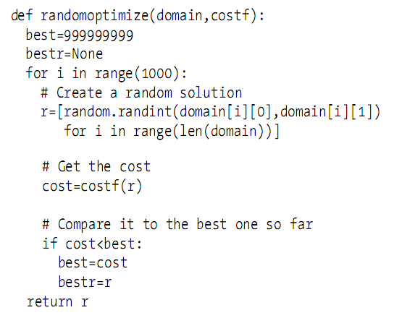
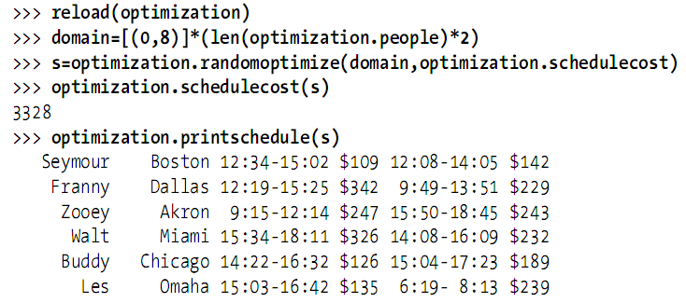
How to Optimize?
Try to begin with random guess – random searching

Slide 10
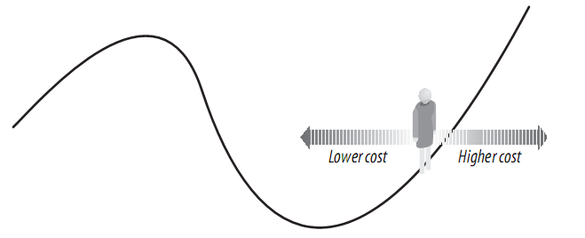
A Better Guess: Hill Climbing
Starts with a random solution
Looks at the set of neighboring solutions for better ones
  Lower cost function

Slide 11
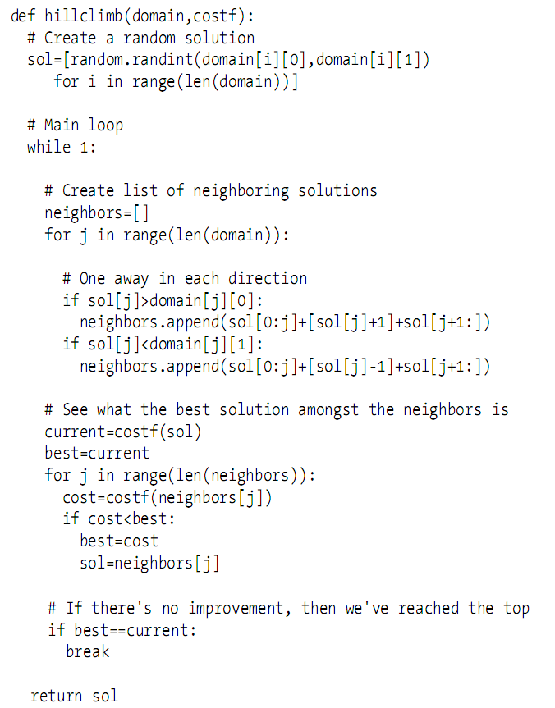
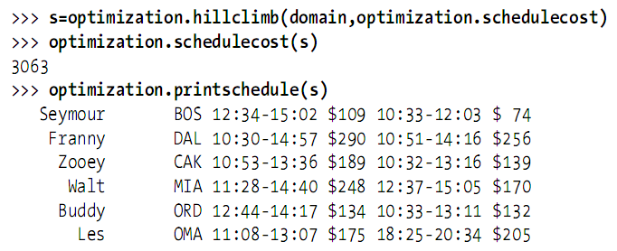
Code: Hill Climbing

Slide 12
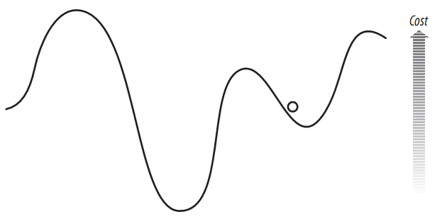
Drawbacks of Hill Climbing
Major problem of hill climbing: local optimum
To solve: random restart technique
  Run several times with random starting points!

Slide 13
Simulated Annealing
An optimization method inspired by physics
Annealing is the process of heating up an alloy and then cooling it down slowly

Slide 14

Flow of Simulated Annealing
Begins with a random solution
Uses a variable as temperature, starts very high and gradually gets lower
Loop: one of the numbers in the solution is randomly chosen, changed in a certain direction, get new cost
If the new cost is lower, replace the old one. If the new cost is higher, replace with a probability
  Attempt to avoid the local minimum problem!
from: http://en.wikipedia.org/wiki/Correlation

Slide 15
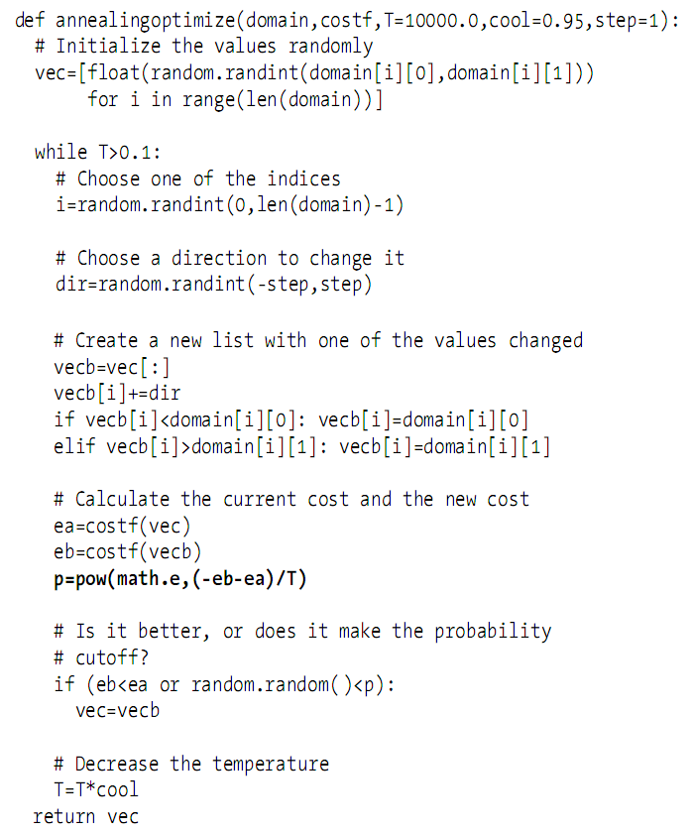
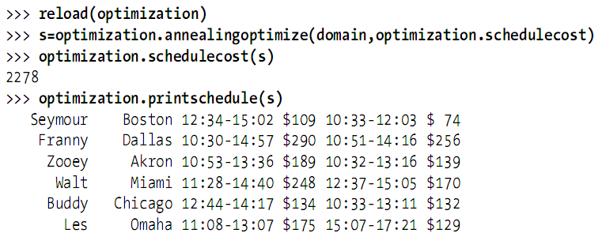
Code: Simulated Annealing

Slide 16

Annealing Schedule

Slide 17
Genetic Algorithms
Create an set of random solutions: population
Loop:
  The cost function for the entire population is calculated
  Get a ranked list of solutions
  Create next generation
    Top solutions are added to the new population: elitism
    Mutation to create new solutions
    Crossover(breeding) to create new solutions
Note not all reviewers have seen all movies!

Slide 18
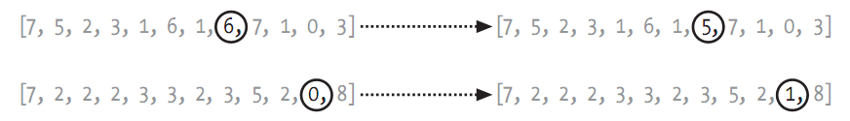
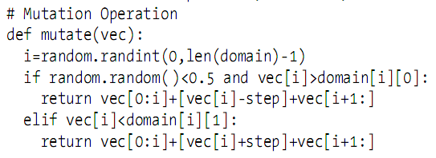
Mutation
Mutate to a neighboring solution at a random position

Slide 19
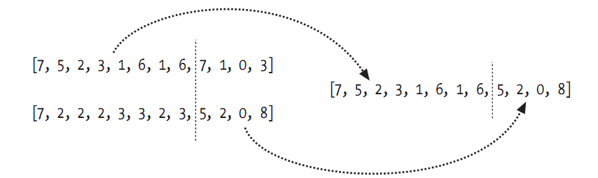
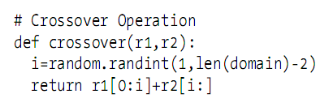
Crossover
A new solution from two parent solutions crossover-ed at a random position

Slide 20
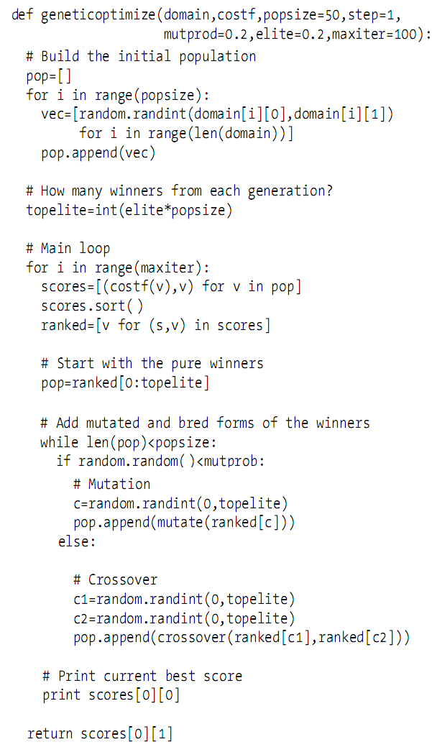
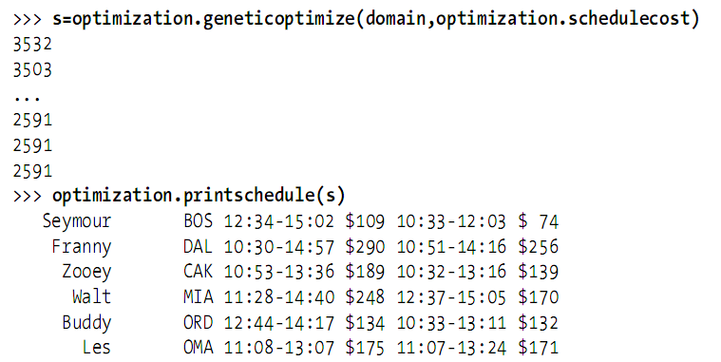
Code: Genetic Algorithms

Slide 21
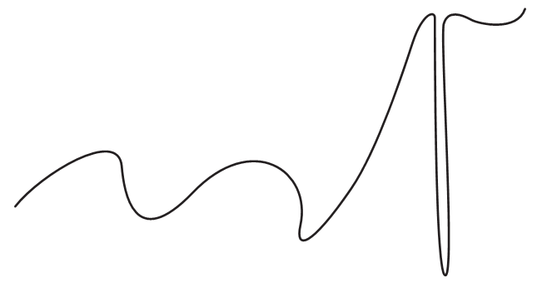
Poor Problem
What bout this?

Slide 22
Summary
Hill climbing can use varying step size to improve
Simulated annealing can also adopt random restart technique to improve
Genetic algorithms generally perform better
Homework:
  Text book p106: Student Dorm Optimization

